Slide 1



How Can “Lust” Circulate across Cultures and Media? A Transmedial Study of Eileen Chang’s Lust.Caution French Interlingual Translation and Film Adaptation
Kevin Henry & Manon Hayette
University of Mons, Belgium

Slide 2
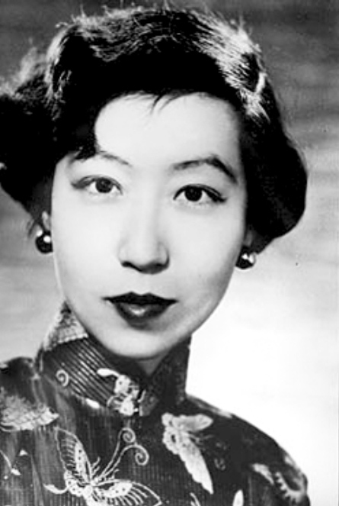
Who was Zhang Ailing?
張愛玲 Zhang Ailing / Eileen Chang (1920–1995)
Renowned and prolific author of contemporary Chinese literature
Gained literary prominence in Japanese-occupied Shanghai and Hong Kong between 1943 and 1945
However, after the Communist takeover of China, she fled the country to live in the United States
Known for her chiselled style full of disillusioned irony, for the strength of her writing and for the depth of her symbolic imagery.
Unique wartime narrative: recount the seemingly irrelevant details and experiences of daily life of ordinary men and women in periods of social change and violence.

Slide 3
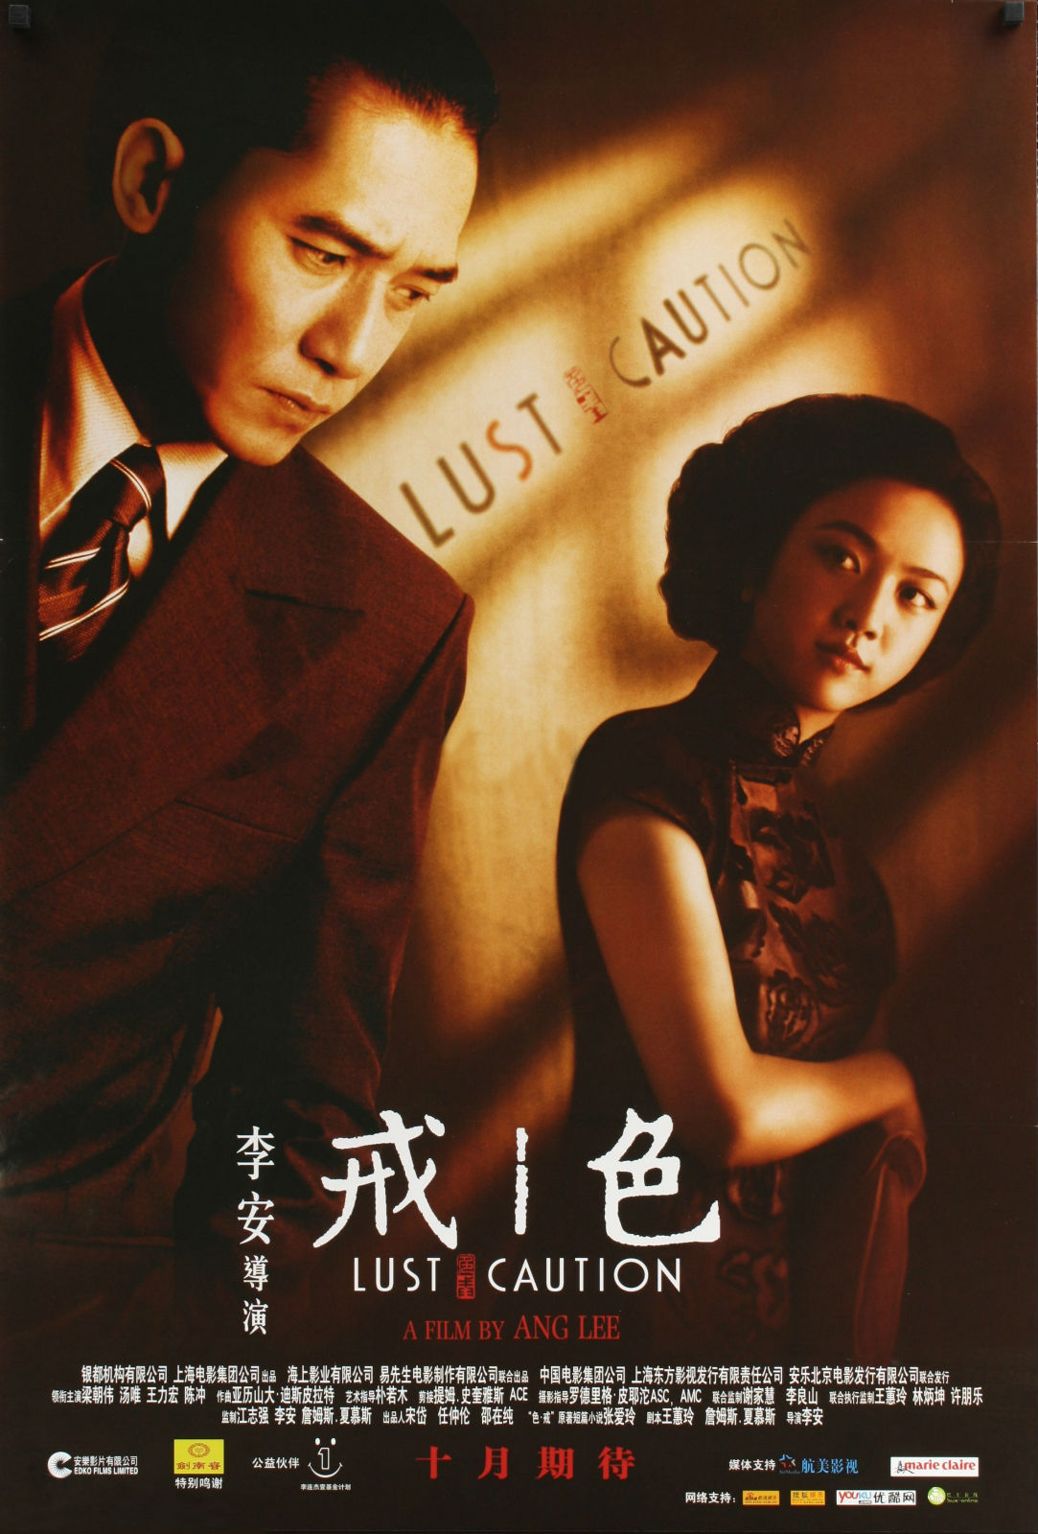
Research goals
Combine translation criticism model (presented in TREXTUALITY 1 in Turku) with study of an intersemiotic translation
Focus on Kaźmierczak’s (2018, 2024) intersemiotic aspects of translation = “a situation of mediating between languages (or comparing language versions) in which taking into account other semiotic codes/layers apart from the verbal one is characteristic or even obligatory”
Study sample: 色·戒 Lust.Caution (1979)
Lust, Caution (2007), film adaptation by Ang Lee
Lust, Caution. Amour, luxure, trahison (2009), transl. Emmanuelle Péchenart

Slide 4

Methodology
Corpus analysis online tool: SketchEngine
Comparison with literary Chinese corpus from the Republican period to extract keywords
Extraction of frequency lists from the original texts
Aim: lexically characterize Zhang Ailing’s style and verify the claims made by literary critics
Selection of excerpts in Lust.Caution based on the findings
Intermedial comparison of Chinese original with the 2009 French translation, and with Ang Lee’s 2007 film adaptation

Slide 5
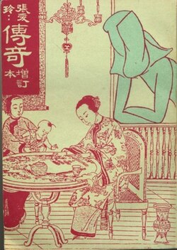
Zhang Ailing corpus
Fifteen major short stories and novellas from the years 1943–1944 contained in the collection 传奇 Chuanqi [Romances], (1944/1946), widely regarded as epitomizing Chang’s oeuvre and having been the subject of several critical analyses (Lin 2007).
留情 Liuqing [Traces of Love] (January 1944) | 沉香屑·第一炉香 Chenxiangxie – Di-yi luxiang [Aloeswood Incense: The First Brazier] (April 1943)
鸿鸾禧 Hongluanxi [Great Felicity] (May 1944) | 沉香屑·第二炉香 Chenxiangxie – Di-er luxiang [Aloeswood Incense: The Second Brazier] (May 1943)
红玫瑰与白玫瑰 Hong meigui yu bai meigui [Red Rose, White Rose] (June 1944) | 琉璃瓦 Liuliwa [The Glazed Tiles] (October 1943)
等 Deng [Waiting] (November 1944) | 心经 Xinjing [The Heart Meridian] (July 1943)
桂花蒸·阿小悲秋 Guihuazheng – A Xiao beiqiu [Shame, Amah! / Steamed Osmanthus Flower – Ah Xiao’s Unhappy Autumn] (September 1944) | 年轻的时候 Nianqing de shihou [In the Years of Youth] (January 1944)
金锁记 Jinsuo ji [The Golden Cangue] (October 1943) | 花凋 Huadiao [A Wilted Flower] (February 1944)
倾城之恋 Qincheng zhi lian [Love in a Fallen City] (September 1943) | 封锁 Fengsuo [Sealed Off / Shutdown] (June 1943).
茉莉香片 Moli xiangpian [Jasmine Tea] (June 1943) | + 色·戒 Se.jie [Lust.Caution] (1979)
Notes:
« Lust, Caution » => began writing in the 1950s, story set during the war, and made Zhang popular again thanks to Ang Lee’s movie

Slide 6
Republican literature corpus
鲁迅 Lu Xun | 呐喊 Nahan [OutCry] (1923); 彷徨 Panghuang [Wandering] (1925) (collections of novellas and short stories)
老舍 Lao She | 骆驼祥子 Luotuo Xiangzi [Rickshaw Boy] (1936) (novel)
Left-wing prominent writers
茅盾 Mao Dun | 子夜 Ziye [Midnight: A Romance of China] (1933) (novel)
巴金 Ba Jin | 家 Jia [The Family] (1933) (novel)
Jingpai
沈从文 Shen Congwen | 边城 Biancheng [Border Town] (1934) (novella); 长河 Changhe [Long River] (1945) (novel)
Haipai
穆时英 Mu Shiying | 黑牡丹 Hei mudan [Black Peony] (1933); 上海的狐步舞 Shanghai de hubuwu [Shanghai Fox-Trot] (1934); 南北极 Nan-beiji [North Pole, South Pole] (1932); 公墓 Gongmu [Public Cemetery] (1933); 白金的女体塑像 Baijin de nüti suxiang [Statue of a Platinum Woman] (1934); Craven“A” (1932); 夜总会里的五个人 Yezonghui li de wu ge ren [Five in a Nightclub] (1933) (short stories and novellas)
刘呐鸥 Liu Na’ou | 都市风景线 Dushi fengjingxian [Cityscape] (1930) (collection of novellas and short stories)
Female writers
丁玲 Ding Ling | 莎菲女士的日记 Sufei nüshi de riji [Miss Sophia’s Diary/The Diary of Miss Sophie] (1928) (novella)
凌叔华 Ling Shuhua | 绣枕 Xiuzhen [Embroidered Pillows] (1925); 酒后 Jiuhou [Intoxicated] (1925); 中秋晚 Zhongqiuwan [The Night of the Mid-Autumn Festival] (1925); 小哥儿俩 Xiaoger lia [Little Brothers] (1935) (novellas)

Slide 7
SketchEngine: results
Critics of Zhang Ailing (Zhang Yinde, Lee Ou-fan, Kam Louie, etc.) emphasize the importance of physical and psychological descriptions of the characters, namely:
through their (family) status;
through their bodies;
through their garments (including with colours);
through the environment.
Frequency list in Zhang corpus + Keyword list compared to Republican literature corpus

Slide 8
Frequency list: nouns
Item number | Item | Frequency by million | Item number | Item | Frequency by million | Item number | Item | Frequency by million
1 | 个 | 8,187.37 | 18 | 年 | 1,048.92 | 35 | 罗杰 | 670.14
2 | 人 | 5,803.03 | 19 | 点 | 1,044.06 | 36 | 声 | 650.72
3 | 太太 | 3,588.65 | 20 | 流苏 | 1,039.20 | 37 | 今天 | 645.86
4 | 道 | 3,107.90 | 21 | 女人 | 1,029.49 | 38 | 张 | 597.30
5 | 先生 | 1,680.21 | 22 | 振保 | 946.94 | 39 | 小寒 | 558.45
6 | 手 | 1,558.80 | 23 | 孩子 | 898.38 | 40 | 嘴 | 548.74
7 | 时候 | 1,519.96 | 24 | 来 | 888.66 | 41 | 头发 | 548.74
8 | 天 | 1,383.99 | 26 | 句 | 825.54 | 42 | 香港 | 543.88
9 | 事 | 1,330.57 | 27 | 次 | 806.11 | 43 | 心 | 529.31
10 | 话 | 1,311.14 | 28 | 母亲 | 786.69 | 44 | 家里 | 519.60
11 | 脸 | 1,301.43 | 29 | 种 | 772.12 | 45 | 小姐 | 514.75
12 | —— | 1,209.17 | 30 | 梁 | 757.55 | 46 | 人家 | 509.89
13 | 只 | 1,204.31 | 31 | 件 | 742.98 | 47 | 柳原 | 505.03
14 | 家 | 1,146.04 | 32 | 身 | 713.85 | 48 | 电话 | 505.03
15 | 薇龙 | 1,136.33 | 33 | 眼睛 | 699.28 | 49 | 眼 | 495.32
16 | 现在 | 1,131.47 | 34 | 老太太 | 684.71 | 50 | 传庆 | 480.75
17 | 头 | 1,092.62 | 26 | 句 | 825.54

Slide 9
Keyword list
Item number | Item | Relative frequency (focus) | Relative frequency (reference) | Item number | Item | Relative frequency (focus) | Relative frequency (reference) | Item number | Item | Relative frequency (focus) | Relative frequency (reference)
1 | 她 | 16,335.89 | 7,260.67 | 18 | 巧 | 1,000.35 | 17.36 | 35 | 喜欢 | 679.85 | 200.93
2 | 道 | 6,968.49 | 560.61 | 19 | 得 | 4,448.18 | 3,620.41 | 36 | 敦凤 | 466.18 | 0.00
3 | 太太 | 3,588.65 | 524.64 | 20 | 七 | 1,116.90 | 297.67 | 37 | 仿佛 | 820.68 | 355.96
4 | 一 | 18,982.46 | 16,129.99 | 21 | 没 | 1,957.00 | 1,147.27 | 38 | 长安 | 461.33 | 1.24
5 | 你 | 10,192.93 | 7528,57 | 22 | 只 | 3,297.28 | 2,511.59 | 39 | 米 | 480.75 | 35.97
6 | 了 | 29,923.22 | 27,234.32 | 23 | 梁 | 757.55 | 3.72 | 40 | 身 | 713.85 | 275.34
7 | 着 | 11,033.04 | 9,329.47 | 24 | 老太太 | 684.71 | 12.40 | 41 | 声道 | 441.90 | 3.72
8 | 笑 | 3,049.62 | 1,467.27 | 25 | 罗杰 | 670.14 | 0.00 | 42 | 别 | 655.57 | 218.29
9 | 上 | 6,108.96 | 4,884.27 | 26 | 女人 | 1,029.49 | 370.85 | 43 | 爱 | 980.93 | 548.21
10 | 薇龙 | 1,165.46 | 0.00 | 27 | 手 | 1,558.80 | 942.62 | 44 | 白 | 796.40 | 367.13
11 | 是 | 15,131.58 | 13,952.04 | 28 | 与 | 1150.89 | 548.21 | 45 | 双 | 592.44 | 167.44
12 | 振保 | 1,160.61 | 0.00 | 29 | 孩子 | 898.38 | 351.00 | 46 | 向 | 1,277.15 | 852.08
13 | 小寒 | 1,141.18 | 0.00 | 30 | 传庆 | 529.31 | 0.00 | 47 | 娇蕊 | 422.48 | 0.00
14 | 里 | 5,676.77 | 4,579.16 | 31 | 香港 | 543.88 | 26.05 | 48 | 太 | 1,087.76 | 668.52
15 | 像 | 1,991.00 | 902.93 | 32 | 柳原 | 514.75 | 0.00 | 49 | 替 | 626.44 | 213.33
16 | 流苏 | 1,053.77 | 1.24 | 33 | 人 | 5,803.03 | 5,303.49 | 50 | 母亲 | 786.69 | 385.73
17 | 先生 | 1,680.21 | 694.56 | 34 | 愫细 | 495.32 | 0.00

Slide 10
SketchEngine: results
The results of our statistical analysis only partially align with the conclusions drawn by literary critics.
Undeniably, women play a dominant role in Chang’s narratives, even if their attires do not stand out, notwithstanding their assumed metaphorical and narratological primacy.
Descriptions appear to be more significant in Chang’s fiction than in the prose of other modern Chinese writers, despite the use of a relatively limited number of adjectives (especially colours).
Furthermore, the focus on the intimacy of the characters is supported by the prevalence of affection verbs, family nouns, and terms referring to body parts.
However, there is a notable dearth of allusions to dwellings in the most common words.

Slide 11
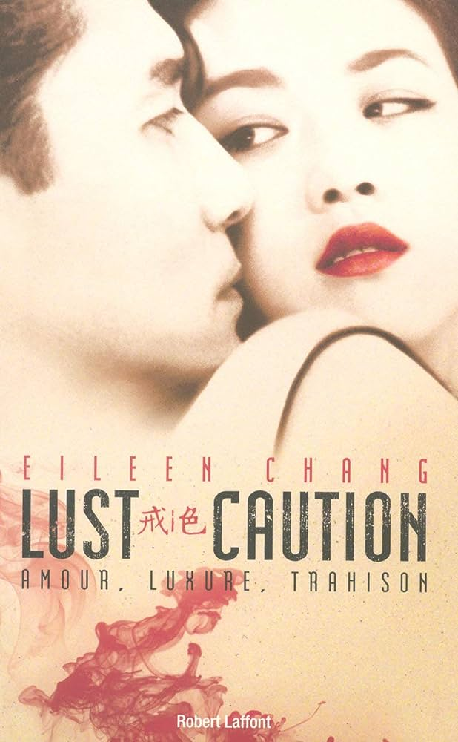
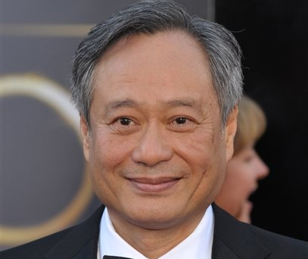
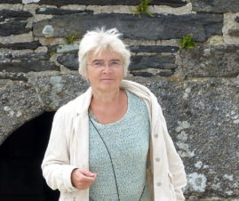
Analysis of excerpts

Slide 12
Analysis of excerpts in Lust.Caution
Excerpt 1: incipit => set up in an intimate locale, description of the female main character, focus on the woman’s body
Excerpt 2: sole clear illustration of “sexual tension” in the novel
Excerpt 3: end of the novel, after the death of the female main character => male gaze of the main antagonist, reducing and degrading the woman

Slide 13
麻将桌上白天也开着强光灯，洗牌的时候一只只钻戒光芒四射。白桌布四角缚在桌腿上，绷紧了越发一片雪白，白得耀眼。酷烈的光与影更托出佳芝的胸前丘壑，一张脸也经得起无情的当头照射。稍嫌尖窄的额，发脚也参差不齐，不知道怎么倒给那秀丽的六角脸更添了几分秀气。脸上淡妆，只有两片精工雕琢的薄嘴唇涂得亮汪汪的，娇红欲滴，云鬓蓬松往上扫，后发齐肩，光着手臂，电蓝水渍纹缎齐膝旗袍，小圆角衣领只半寸高，像洋服一样。领口一只别针，与碎钻镶蓝宝石的“纽扣”耳环成套。
（张爱玲 2019, p. 239）
Des lampes puissantes éclairaient même en plein jour la table de jeu ; sur les mains qui mélangeaient les tuiles de mah-jong, les bagues jetaient tous leurs feux. La nappe d’un blanc immaculé était fixée aux quatre coins de la table, ajustée et blanche au point d’en devenir aveuglante. Les lumières constrastées mettaient en valeur les formes de Chia-chih, ses lignes vertigineuses, comme son visage, souffrant sans peine l’agressivité de l’éclairage direct. Sur un front qu’on aurait pu trouver étroit, l’implantation des cheveux, pourtant capricieuse, ajoutait encore au charme de ce gracieux visage hexagonal. Le maquillage était léger, hormis un rouge à lèvres éblouissant dont la teinte fraîche exaltait sa bouche mince et bien dessinée. La chevelure, bouffante et ramenée très haut sur le front, descendait jusqu’aux épaules, au-dessus des bras nus. La robe de coupe chinoise, en satin moucheté bleu électrique, s’arrêtait sous le genou, et son petit col droit, haut d’un demi-pouce à peine, ressemblait à celui d’un vêtement occidental. La broche agrafée au col, assortie aux boucles d’oreille boules, était sertie d’éclats de saphir.
(Zhang 2009, p. 127-128 => Péchenart’s official translation)

Slide 14
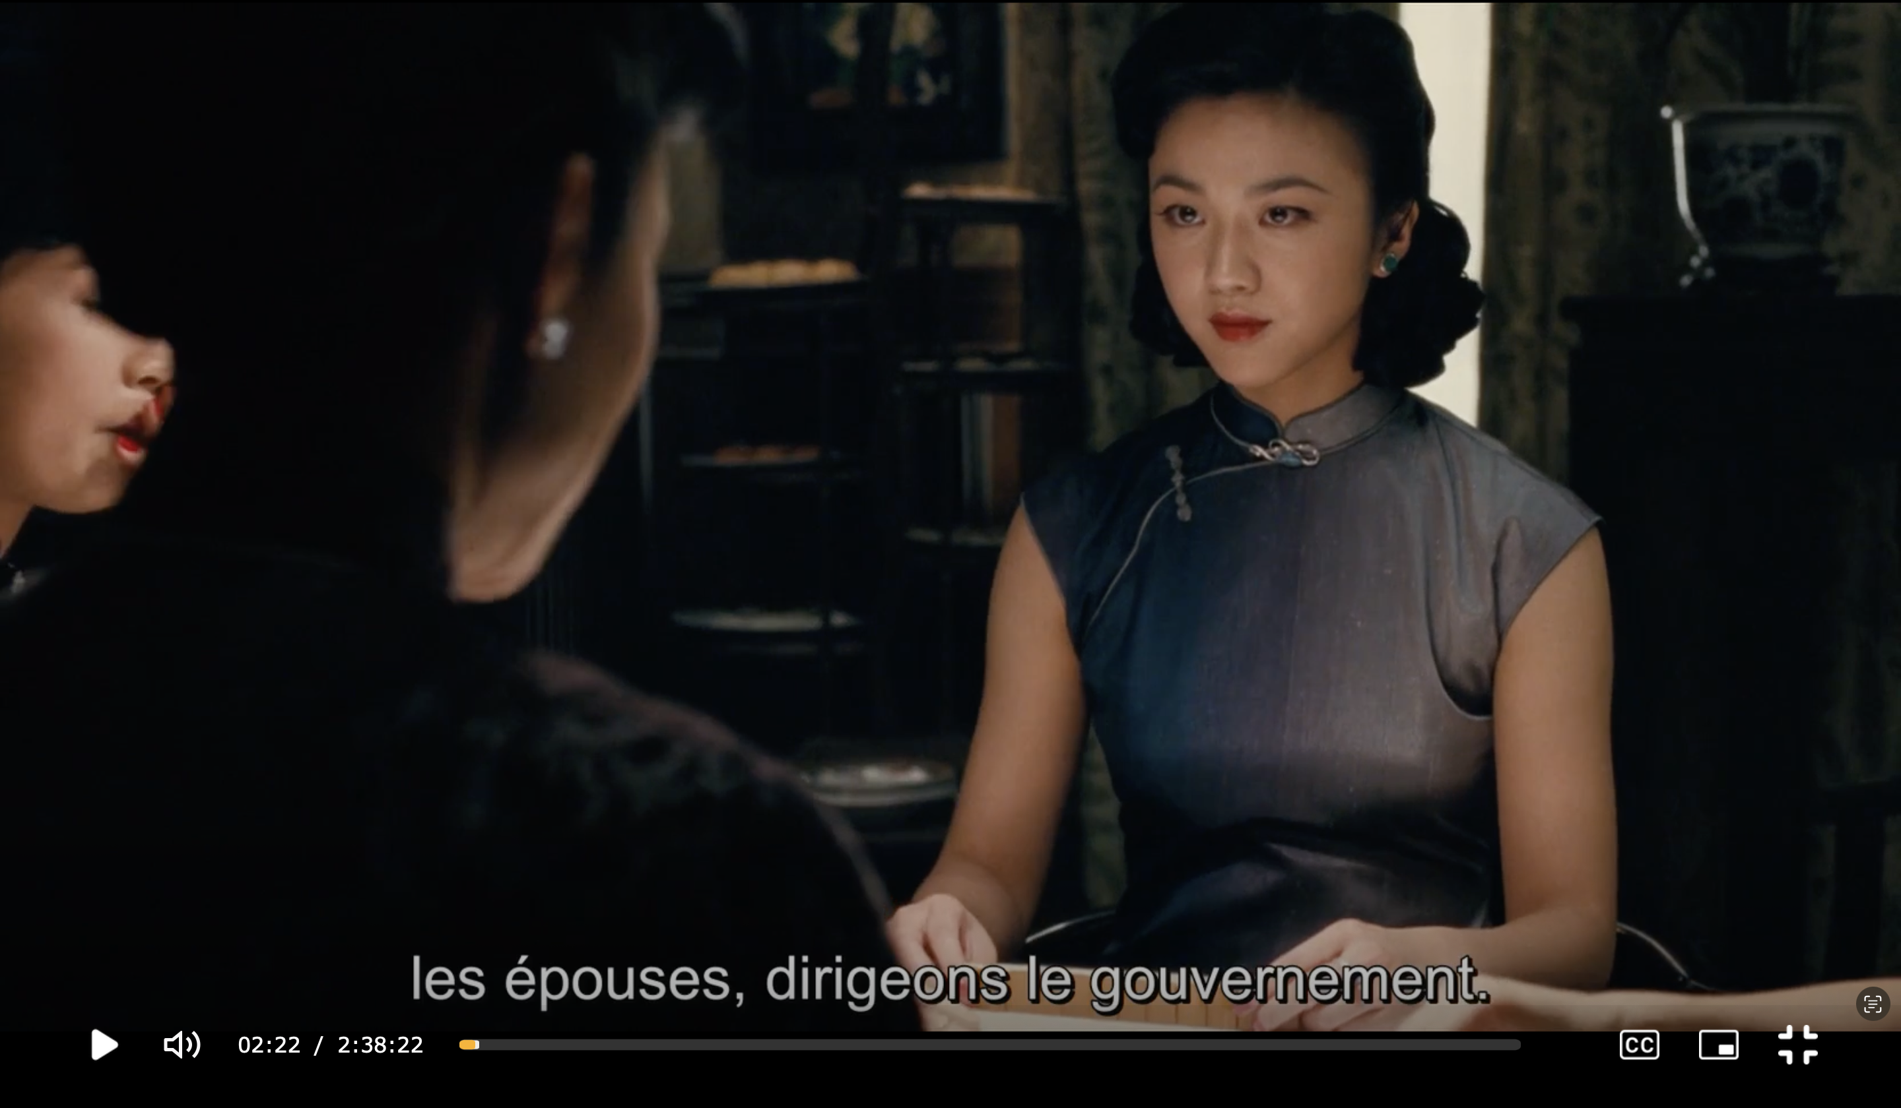

Slide 15
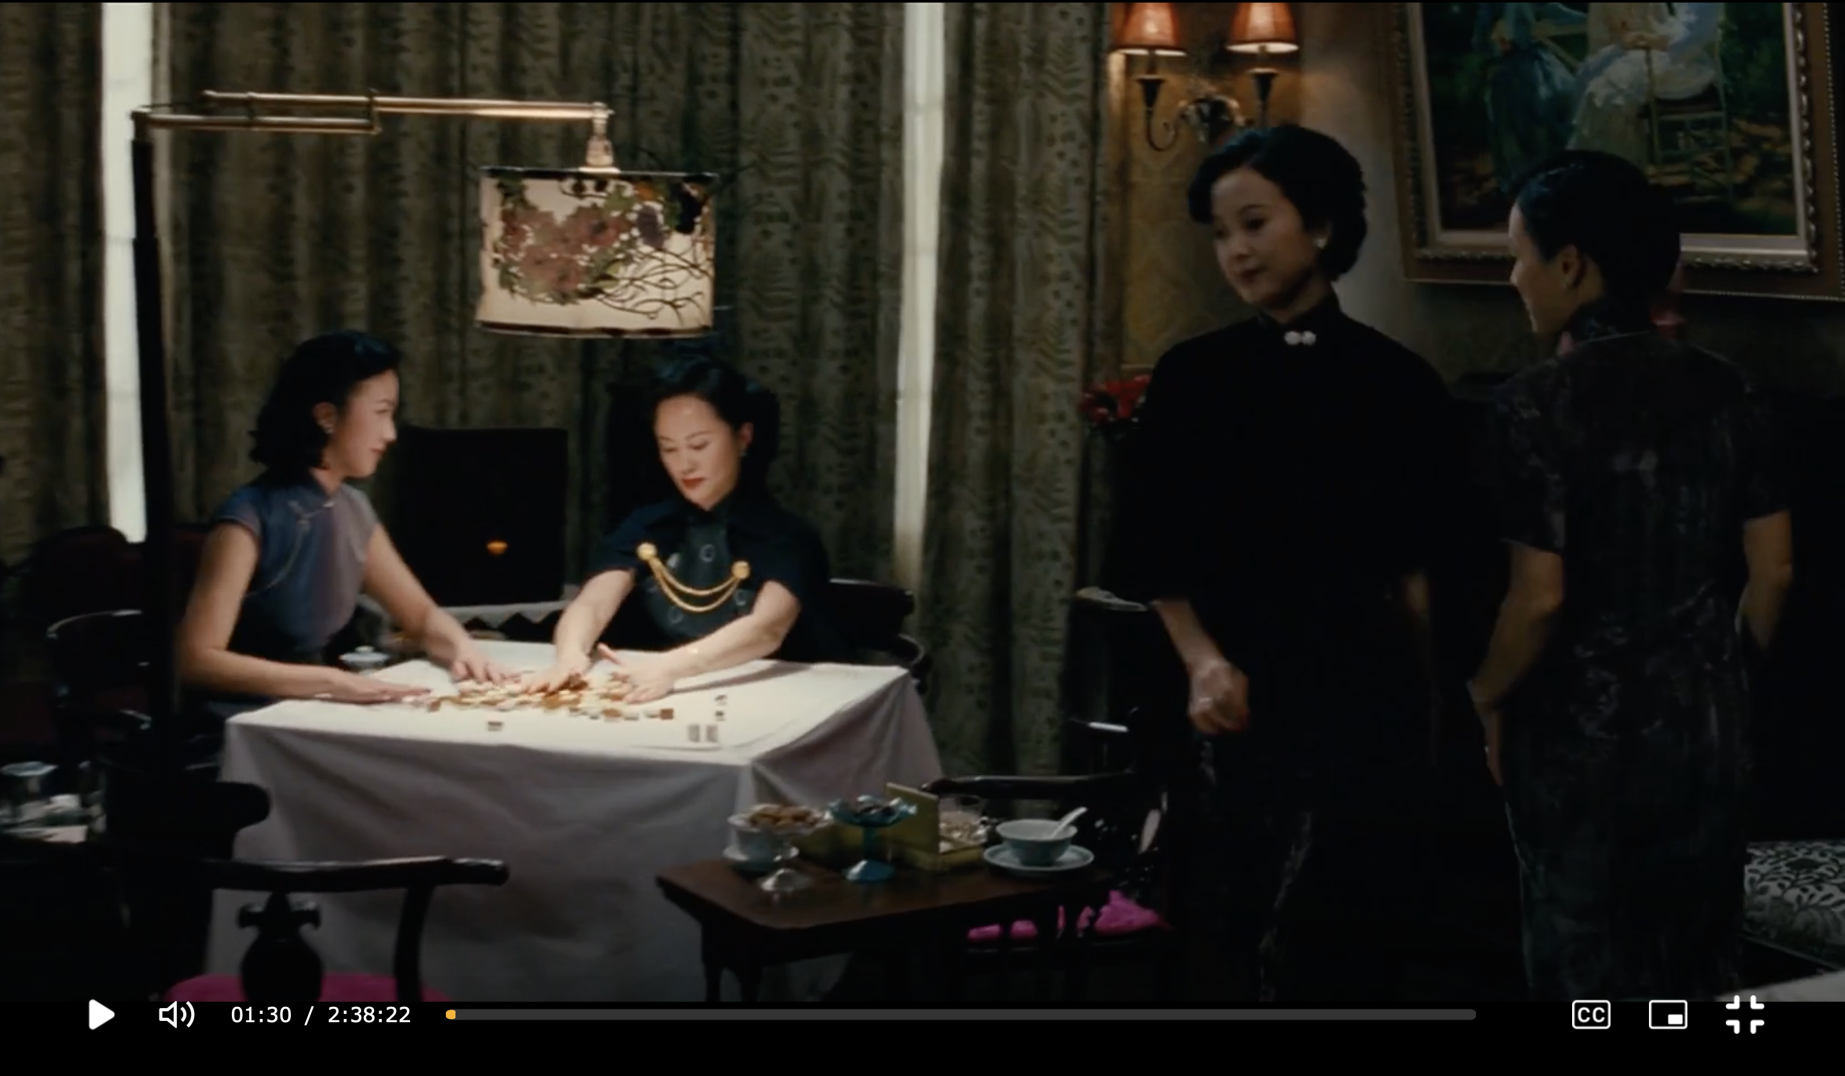

Slide 16
[…] 不去找他，他甚至于可以一次都不来，据说这样的事也有过，公寓就算是临别赠品。他是实在诱惑太多，顾不过来，一个眼不见，就会丢在脑后。还非得钉着他，简直需要提溜着两只乳房在他跟前晃。
“两年前也还没有这样哩，”他拥着吻着她的时候轻声说。
他头偎在她胸前，没看见她脸上一红。
就连现在想起来，也还像给针扎了一下，马上看见那些人可憎的眼光打量着她，带着点会心的微笑，连邝裕民在内。
只有梁闰生佯佯不睬，装作没注意她这两年胸部越来越高。演过不止一回的一小场戏，一出现在眼前立刻被她赶走了。
（张爱玲 2019, p. 244）
[…] Si elle ne se décidait pas à le chercher elle-même, il pourrait même ne plus jamais revenir et lui laisser l’appartement en guise d’adieu — ce genre de chose se faisait, paraît-il. Il était soumis à de multiples tentations ; hors de son champ de vision, elle disparaîtrait de ses priorités. Pour le harponner une bonne fois, elle devait persévérer à lui promener ses seins sous le nez.
— Ils n’étaient pas comme ça, il y a deux ans, lui disait-il à voix basse en les pétrissant et en les embrassant.
Le visage enfoui dans sa poitrine, il ne voyait pas combien elle rougissait.
En y repensant à présent, elle ressentait toujours la même brûlure, elle revoyait immédiatement les regards détestables de ces gens qui la regardaient avec un sourire entendu, K’uang Yü-min compris. Seul Leung Jun-sheng, l’air détaché, faisait mine de ne pas remarquer combien elle avait pris de poitrine au cours de ces deux années. La scène s’était jouée plus d’une fois, des images qu’elle chassait dès qu’elles lui revenaient en mémoire.
(Zhang 2009, p. 138 => Péchenart’s official translation)

Slide 17
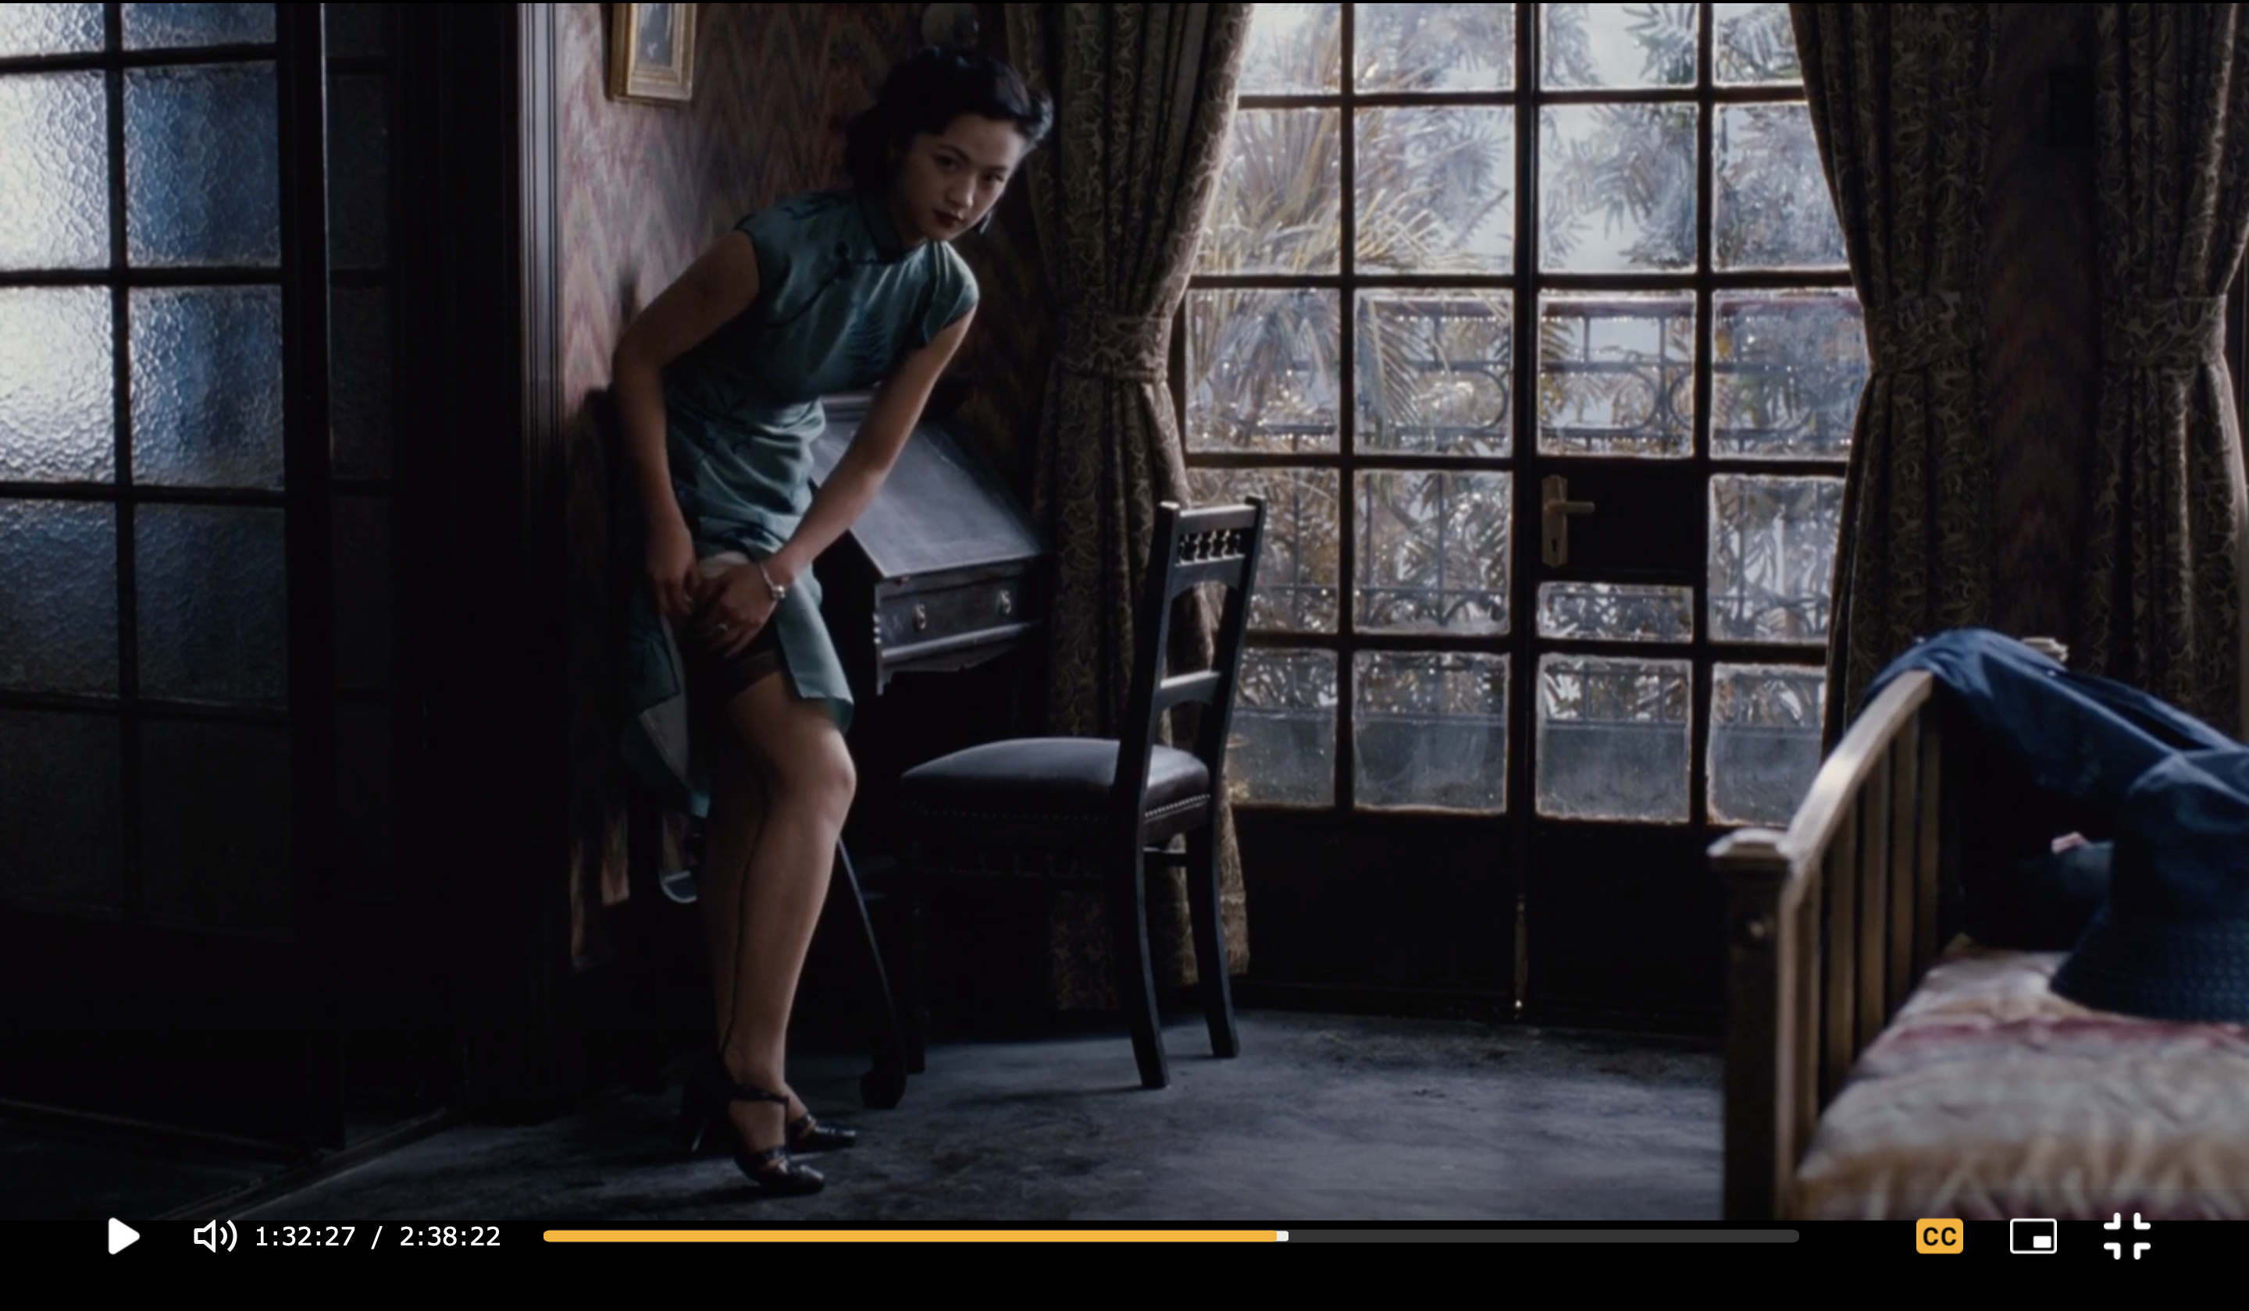
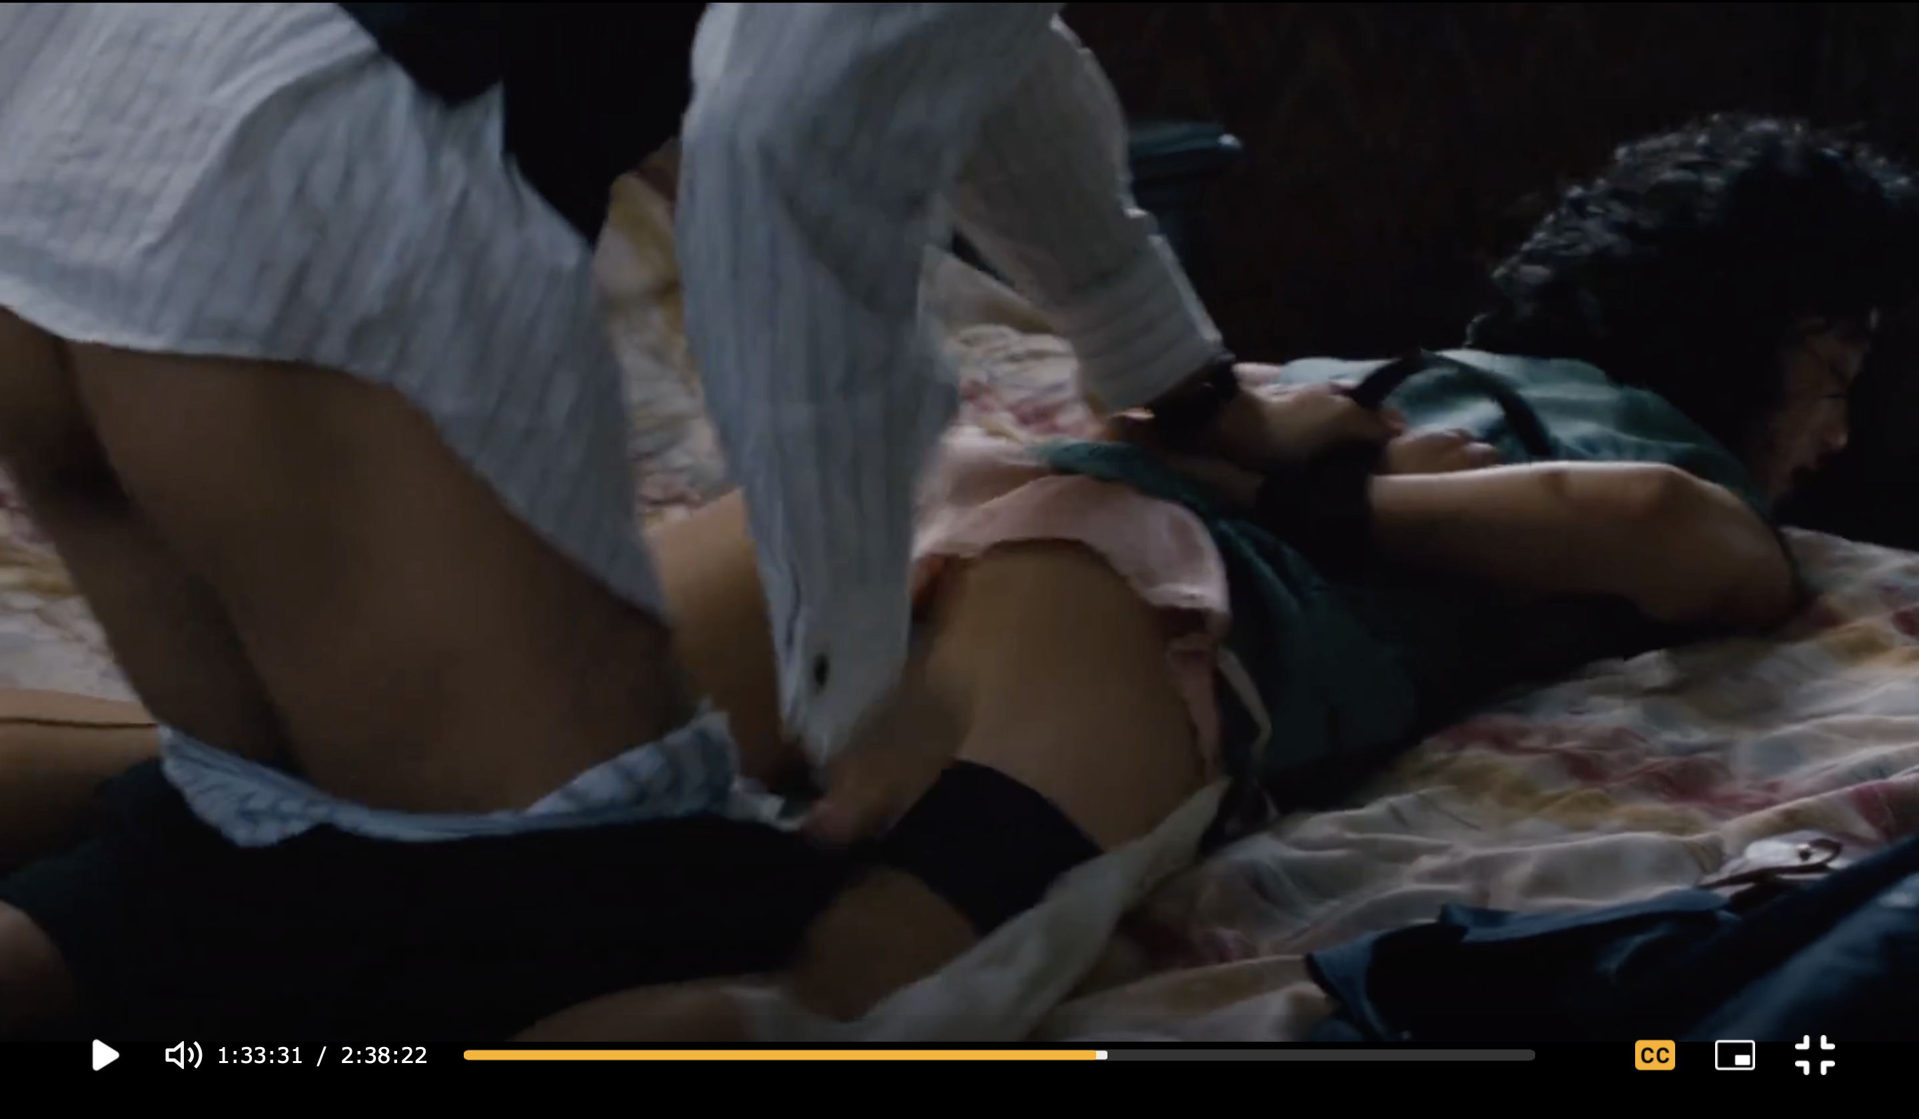
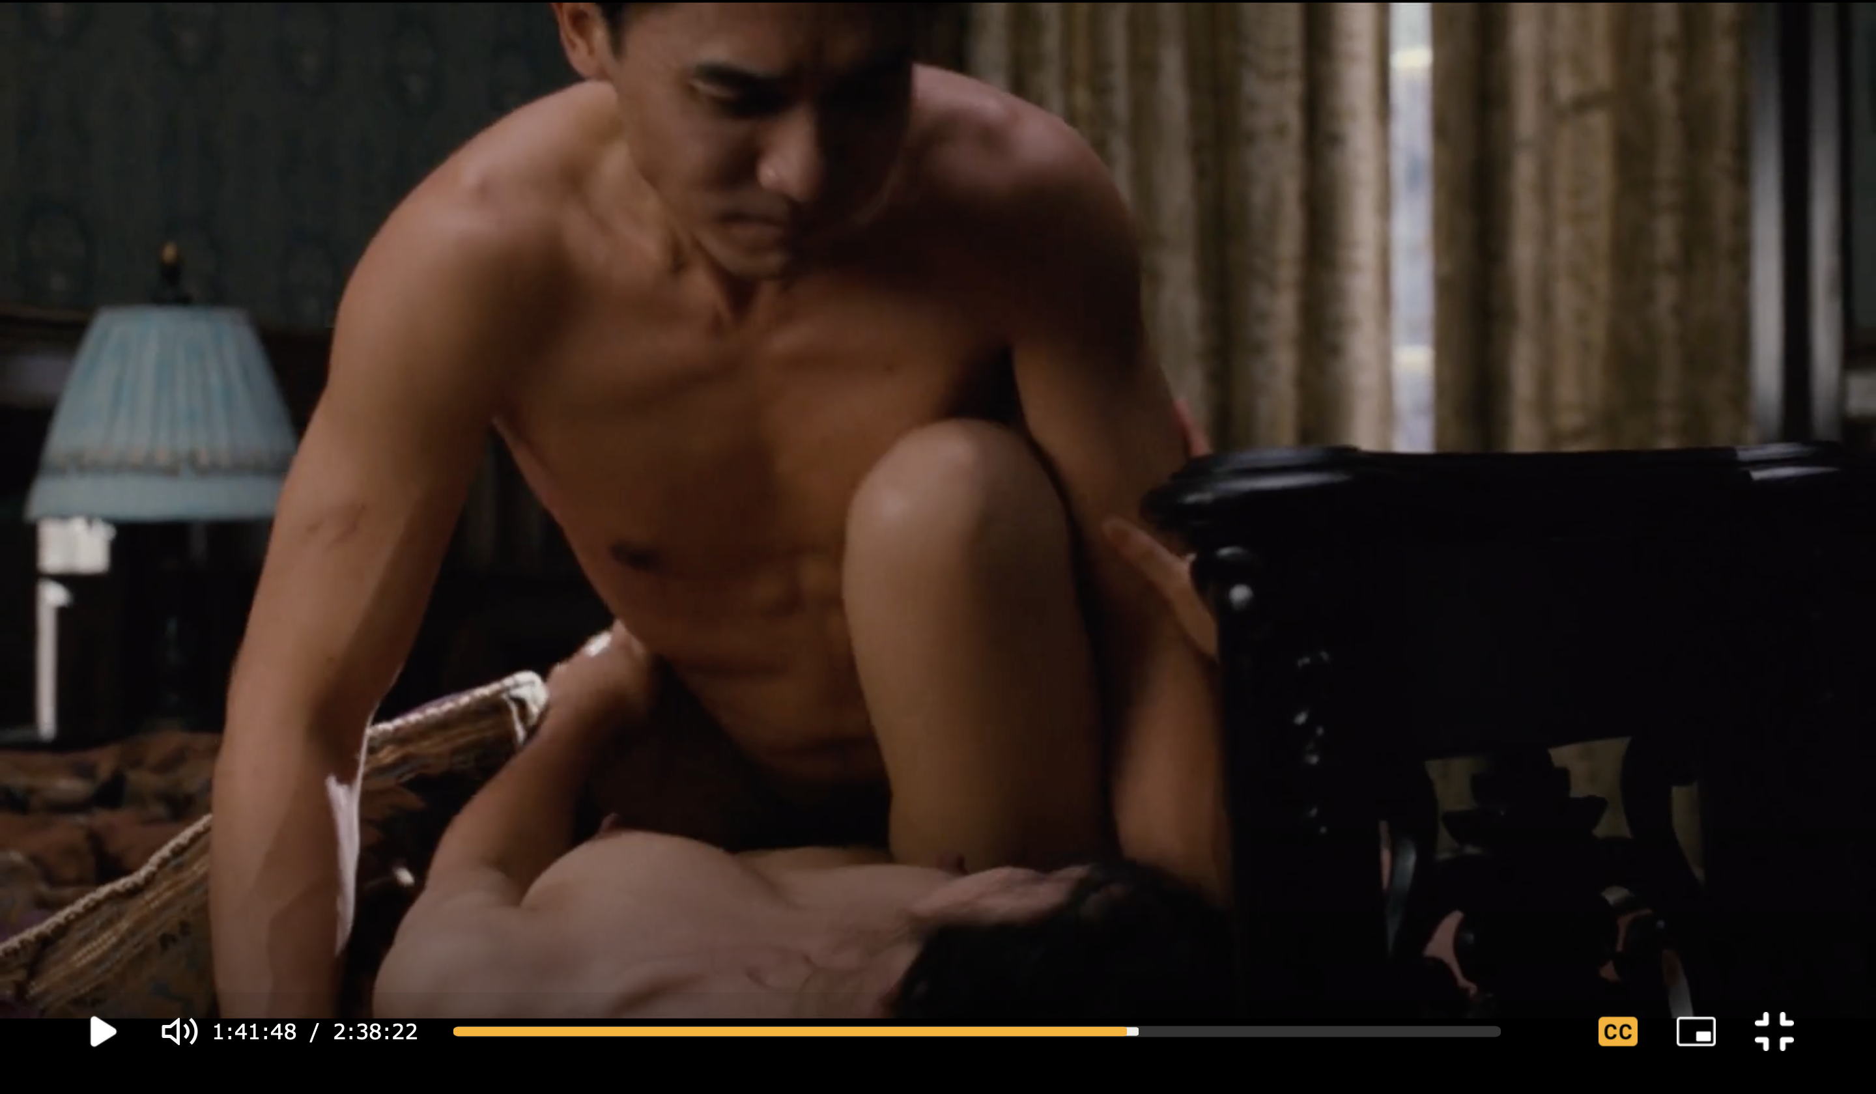

Slide 18
他对战局并不乐观。知道他将来怎样？得一知己，死而无憾。他觉得她的影子会永远依傍他，安慰他。虽然她恨他，她最后对他的感情强烈到是什么感情都不相干了，只是有感情。他们是原始的猎人与猎物的关系，虎与伥的关系，最终极的占有。她这才生是他的人，死是他的鬼。
（张爱玲 2019, p. 261）
Il n’était pas optimiste sur l’issue de la guerre. Qui savait ce qu’il adviendrait de lui ? Il avait rencontré l’âme sœur, et pouvait mourir sans regret. Il sentait que son ombre l’escorterait à jamais. Même si elle éprouvait de la haine contre lui, les sentiments qu’elle lui vouait en sa dernière heure étaient d’une telle force que leur nature importait peu, pourvu qu’ils existent. Elle et lui étaient unis par le même lien primitif que le chasseur et sa proie, le tigre mangeur d’homme et sa victime, devenue son âme damnée. La plus intime et la plus extrême possession. Vivante, cette jeune femme lui avait appartenu, morte, son fantôme lui appartenait.
(Zhang 2009, p. 173 => Péchenart’s official translation)

Slide 19
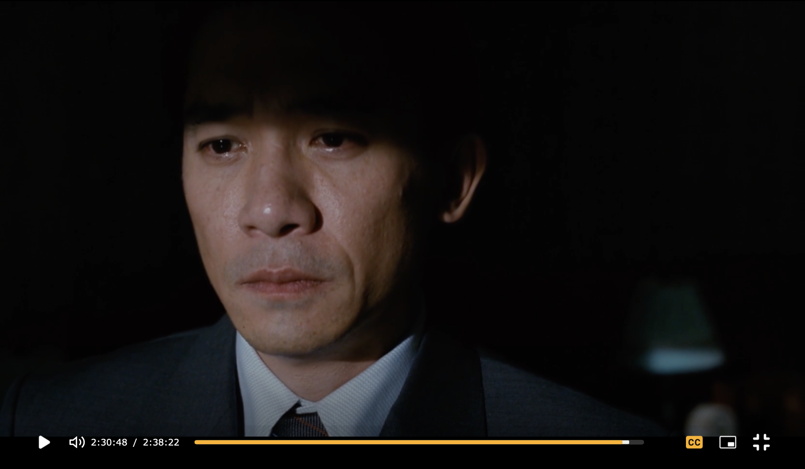
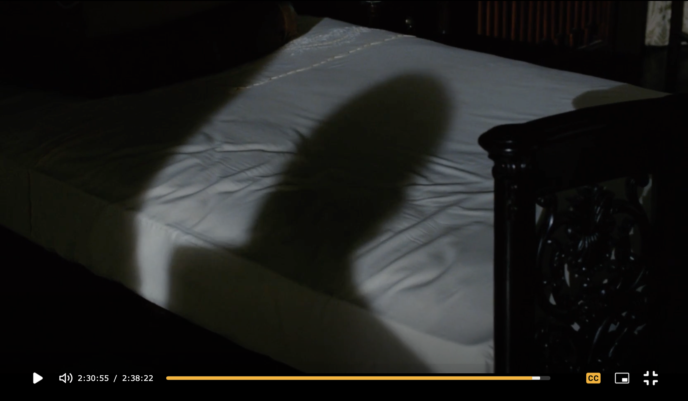

Slide 20
Conclusions
The French interlingual translation, just like Julia Lovell’s English version “places a ‘heavier’ emphasis on women’s bodies, suggesting the suppression women suffer in a patriarchal society” (Hui 2022).
Both in the film and the interlingual translation, the supposed importance of attire and character description in Chang’s work as a means of revealing the condition of women, “mentally imprisoned by traditional values” (Zhang 2003:349), is confirmed.
It is inferred that the French translation, published two years after the film adaptation, was somewhat transmedially influenced by it, exaggerating the sexual tension and the male gaze on the woman’s body.

Slide 21
References
Chang, Eileen. 2008. Lust, Caution. Amour, luxure, trahison, trans. Emmanuelle Péchenart. Robert Laffont.
张爱玲 Chang, Eileen. 2019. 《张爱玲全集》 Zhang Ailing quanji [Zhang Ailing’s Complete Works], 5 volumes. Beijing Publishing Group.
Elleström, Lars. 2023. Intermedial approaches. In: Meynaerts, R. & Marais, K. (eds). The Routledge Handbook of Translation Theory and Concepts (pp. 389–409). Routledge.
Hui, Isaac. 2002. “It is still light outside” Reading and translating Se, Jie and Lust, Caution as world literature. FORUM. Revue internationale d’interprétation et de traduction / International Journal of Interpretation and Translation, vol. 20, issue 1, pp. 44–64.
Kam, Louie (ed.). 2012. Eileen Chang: Romancing Languages, Cultures and Genres. Hong Kong University Press.

Slide 22
References
Kaźmierczak, Marta. 2018. From Intersemiotic Translation to Intersemiotic Aspects of Translation. Przekładaniec. A Journal of Translation Studies 34–35 (English Issue: Word and Image in Translation): 7–35.
Kaźmierczak, Marta. 2024. Intermediality and/in Translation. In: Bruhn, J., Azcárate, A.LV., de Paiva Vieira, M. (eds) The Palgrave Handbook of Intermediality (pp. 285-319). Palgrave Macmillan.
Lee, Leo Ou-fan. 1999. Shanghai Modern: The Flowering of a New Urban Culture in China, 1930–1945. Harvard University Press.
Peng, Hsiao-yen & Whitney Crothers, Dilley. 2014. From Eileen Chang to Ang Lee: Lust/Caution. Routledge.
Zhang, Haoxuan. 2023. Exploring Intersemiotic Translation Models: A Case Study of Ang Lee's Films. Routledge.
Zhang, Yinde. 2003. Le Monde romanesque chinois au XXe siècle. Honoré Champion.

Slide 23
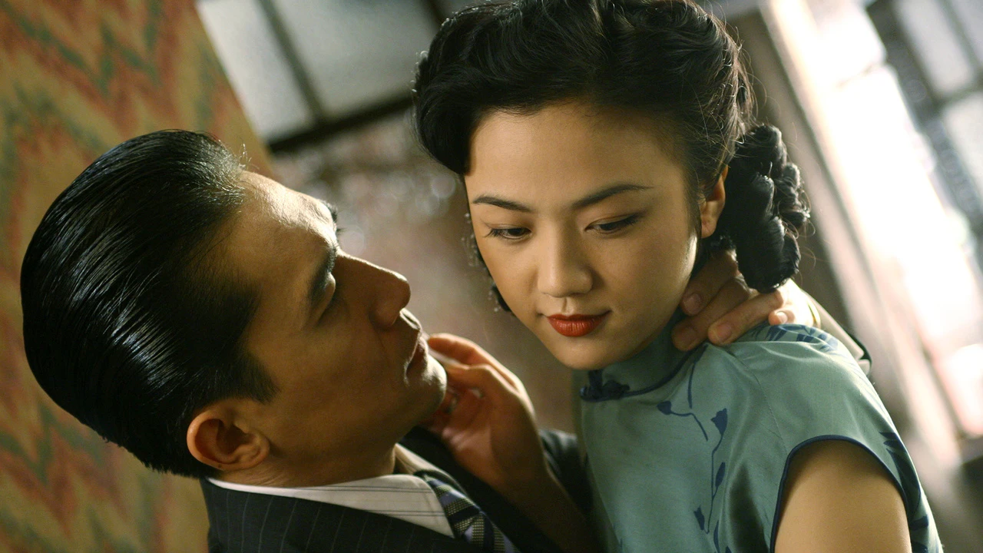
Thank you for your attention!

